Slide 1
Things I’ve Done Wrong in React.js
Josh Doro
Notes:
Hello, My name is Josh Doro and I’m here to confess the mistakes I made while learning the React Javascript library by facebook.

Slide 2

Who Am I?
Senior Technical Architect with nvisia
nvisia for almost 9 years
Working with React.js for 7
Notes:
7 years working with a lot of react at multiple clients helping teach react and update best practices

Slide 3
About nvisia
Software consulting firm
Offices in Chicago and Milwaukee
A group of passionate technologists who like to help create cool software.
Involved in tech community
Notes:
NEEDS WORK!!

Slide 4

Bad Code
Notes:
Who here has felt like they've written some bad code in their career?
Who has nightmares about that code and your experience maintaining it?
Anyone's bad code still running in production?
I made A LOT of mistakes while learning react. I've written some ugly code in react that worked great but boy were there better ways to do it to make it more readable and maintainable.
This talk is my confession of what I now consider mistakes in react.
The very first being...

Slide 5
I Made Components Too Big
Notes:
I’ve made components way too big.
Not just in their file size but in what their responsibilities are.
Components are supposed to be reusable and the more you put in them the less reusable they become.

Slide 6
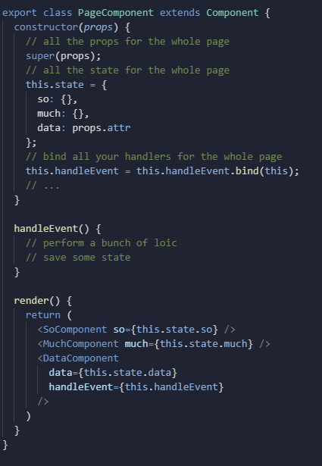
Page Component
One component with all of the state
Notes:
This first way I made components too big is by putting all of my state and logic inside my page components.
As you can see in this example, it’s an old class example but the concepts is the same,
the component has all this state and some event functions and it all needs to be passed into its child components without doing much with it itself.
All of that state that had nothing to do with each other had to be passed down into the components that actually care
Not only did that make it so effectively the whole page rendered every time anything changed it also made most of our components less reusable.

Slide 7
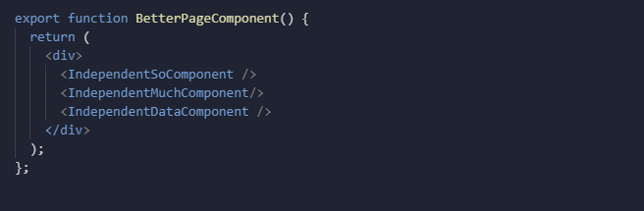
Page Component Remedies
Think about the render cycle – What all needs to render when this value changes?
Components without state are ok
Centralized State management(Context, Redux, Apollo, etc..)
Notes:
Page components are a necessity to have a component for your route to navigate to and to organize the individual pieces of a page but they shouldn’t be holding much if any state.
I also became more ok with stateless components. Initially I wasn’t aware of stateless functional components. I made every component a full class meaning they all had potential for state and they all had lifecycle methods I could play with. I know I don’t have any hook examples on here because they didn’t exist while I was learning these lessons but I do feel like is something lost when we’re not intentionally making a class component to hold state and now we’re back to having state everywhere.
And finally when I do actually need to share state we start to think about centralized state management like context or redux that allow me to store my state outside of my components entirely and only expose that state directly to the components that will need it.
See now this page component has no state because it didn’t actually need any of it and each individual child can take care of itself.

Slide 8
Over-Generalized Components
<SuperComponent
data={}
overrideAction={() => {}}
isActive
isAfterMidnight
hasSuperspeed
isBird
isPlane
isDarkMode
/>
This component Can do everything!
We'll never need to make another like it!
Notes:
Then there’s taking the quest for reusability too far and I think everyone can relate to doing something like this in any software they’ve written. I tried to make components that could do everything. I’d never have to make anything like it again. This abstraction will cover all of the problems I could ever face. This is just another form of pre-optimization that we’re always tempted by

Slide 9
What I thought I made:
The perfect abstraction that will last forever.
What I really made:
tests
Notes:
But it’s easy to take this too far and end up with something incredibly complex that is challenging to maintain. I was writing tests for features that were never used.

Slide 10
Composability
Render props
Higher order Components
Custom hooks
Notes:
Now I try to only give components the functionality they need right now.
And when I do think there is some reusable functionality that I can factor out I tried to think about composability either just by making components that wrap components or using more complex patterns like render props and higher order components.
And those could be whole talks on their own

Slide 11
I Defined Components Inside Components
Notes:
Once I started breaking out components it became difficult to figure out how to pass state around between these components. One of the patterns I initially tried was defining components inside of components.

Slide 12
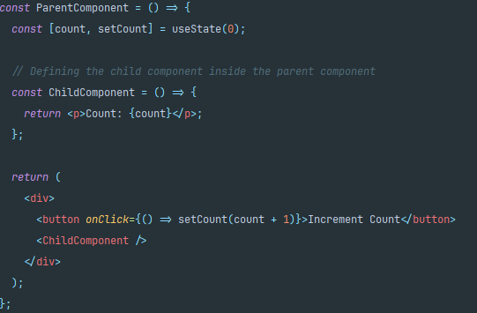
Redefined on Every Render
Notes:
This is not how react was meant to work. As you can see this child component does have access to the state BUT We are initializing a brand new component on every render. That means the new component is mounted which takes extra cycles. In addition to that, this child component cannot have it’s own state because it would always be remounted and will always be reset. The state is completely coupled to the parent is any function is defined within a component.

Slide 13
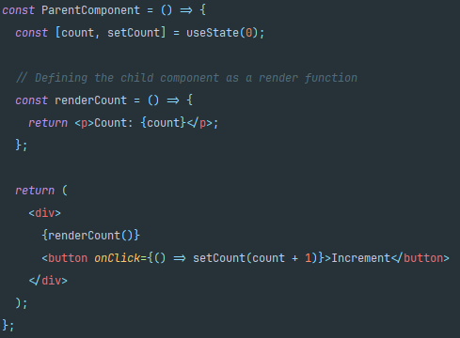
Render function
Notes:
The simplest solution if this chunk of code truly doesn’t ever need it’s own state or lifecycle, just call it as a function. Then you can get all of the benefits without the performance boost or lying to the person reading the JSX. They know exactly how this component was meant to work.

Slide 14
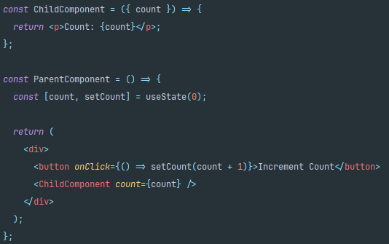
Defined Outside Life-Cycle
Notes:
The best solution is define all components completely outside of react’s life-cycle. As you can see here the child now just takes in the count as a prop and it will mount and update and unmount just like any other component. Any enhancements made to the child component will work. If we wanted to add state or a side-effect or conditionally render that component it will mount and unmount as the component is in the virtual DOM.

Slide 15
I Made Copies of State
Notes:
While working with inputs in react it becomes tempting to take an input and use it to initialize some new state within the component. But that comes with its own suite of problems.

Slide 16
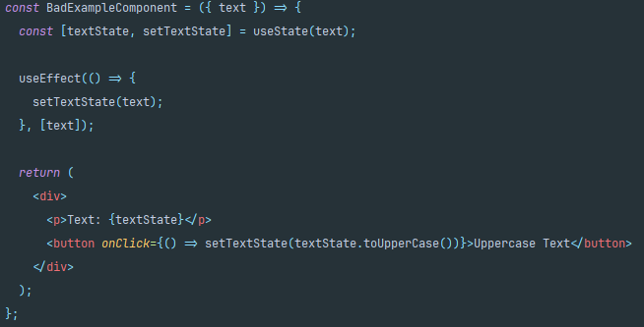
Keep it In-Sync

Slide 17
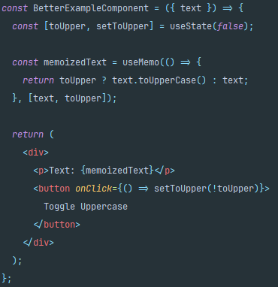
Derive it!

Slide 18
I Stored Deep Objects in State
Notes:
Now, when you’re writing an api many times it feels like it makes sense to create smaller objects inside of your response object that group together seemingly related data.
Unfortunately that makes things more complicated in React.
Many times you end up storing way more than you need.

Slide 19
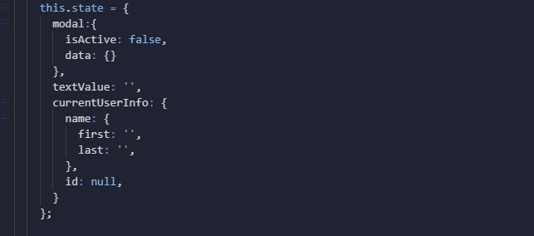
Deep object in React state
Notes:
If you look at this example we have some modal state that is an object and while not ideal 1 layer down isn’t so bad.
But we also have some currentUserInfo state that is an object and inside that object we have another object that is a name and that name is composed of two attributes first and last.
Logically this makes sense. CurrentUserInfo.name.last
You’ll have the pain of checking for existence of each object along the way but that’ par for the course in JS. It’s not exclusive to react.
But what if you want to update just a piece of that state?

Slide 20
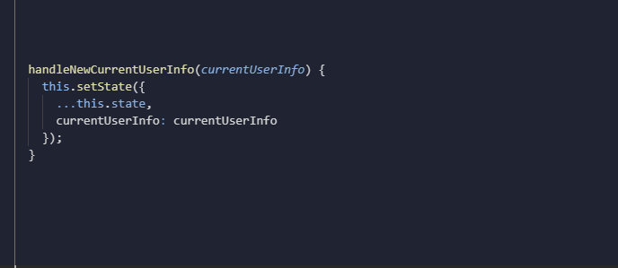

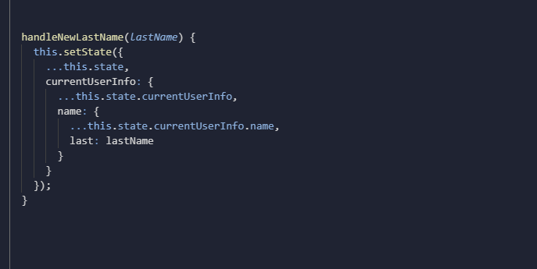
Immutability
Updates
Unnecessary renders
Notes:
Immutability comes into play. Which is a core principle in react. To keep react fast it doesn’t compare the values in state it only does a shallow comparison to validate that it is still looking at the exact same data in memory that it was looking at before.
Updating the whole Current user object is simple enough.
But what if we want to update just the last name of the current user?
That’s always ugly to look at and that’s only 3 levels deep. Imagine how tough that is to follow one it gets a few levels deeper.
Inevitably, bugs come from this. State that wasn’t meant to update was updated and the shallow compare caused more renders than were necessary

Slide 21

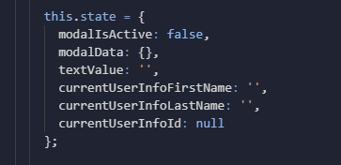
Flatten it!
Notes:
Now if I have control over the api I try to send a flat object when I can.
And when I don't have control over the api I try to flatten the data before I set it into state.
Sure each attribute becomes a little verbose but it’s usually well worth it in the long run.

Slide 22
I Abused React's Life-Cycle
Notes:
This one was particularly egregious.
The component life-cycle sounded like a good idea on paper but you could do some really bad stuff with these. The react team has now deprecated many of these since they were just getting people into trouble.

Slide 23
Pre-hooks
componentWillMount(removed)
componentDidMount
componentWillReceiveProps(removed)
componentWillUpdate(removed)
shouldComponentUpdate
componentDidUpdate
componentWillUnmount
Notes:
Hooks didn’t exist when I started writing react so we were using class components and class component came with a wide array of different lifecycle hooks that you could override to perform logic and different points in a components lifecycle. This was bad. You could do a lot of bad things.

Slide 24
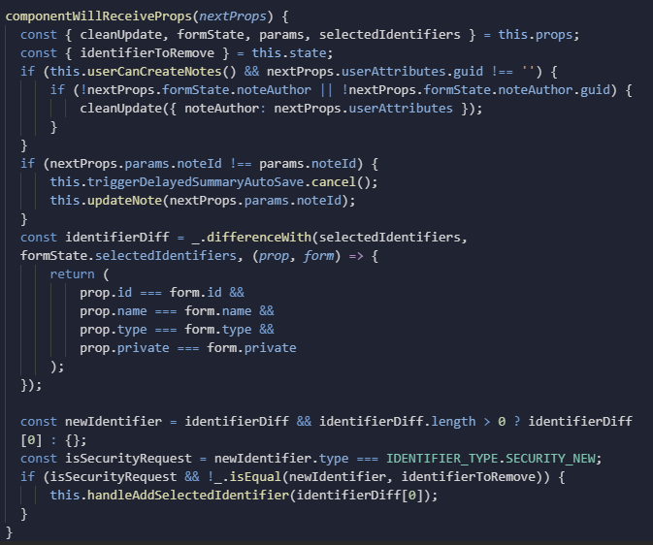

Notes:
I don't expect everyone to process what is happening here. But this is code that is still in production that I am responsible for.
It works but it took many hours of delicately trying to balance this house of cards.
Every little change affects it and causes a new chain reaction of problems.
So in the future if you ever see code that’s using componentWillRecieveProps remember Mr. Yuk Means No! Stay Away!
Yes, I wrote this. Not my finest work but miraculously that’s a completely functional component and i really hope that client has gotten around to throwing that thing away by now.

Slide 25
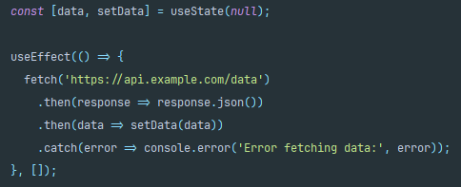
A new way to abuse lifecycle - useEffect
Side Effects
Runs whenever one of it's dependencies changes
An empty dependency Array means it only runs on mount
Returning a function will call that function on unmount
Notes:
I’m sure no one cares about the old ways you could mess up. You’re all using hooks now and hooks solved everything, right?
Has anyone seen or written logic where you strung useEffects together where one depends on another depends on another depends on another until you can’t follow the series of events that need to occur? This can easily become almost as gross as the code I just showed you.

Slide 26
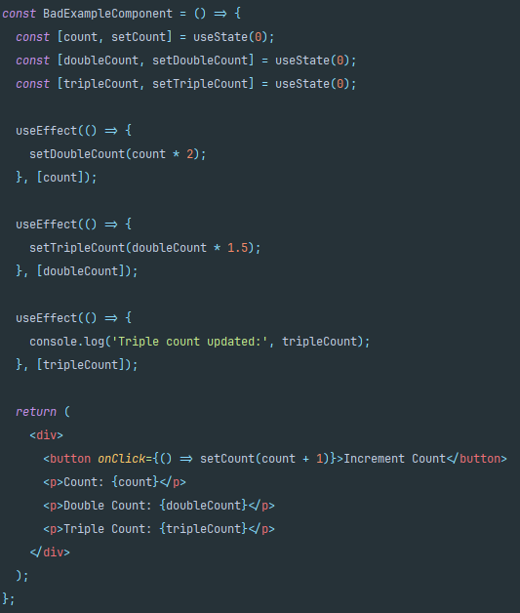
useEffect
Notes:
UseEffect should be used sparingly. It is for managing side-effects and we want to do our best to keep those to a minimum. Remember, React is more functional. functional programming depends on pure functions and pure functions do not have side-effects.

Slide 27
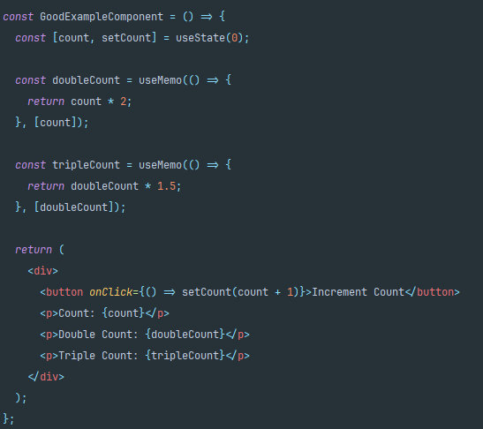
useMemo

Slide 28
I tried to Learn Too Many Things at Once

Slide 29
Library! Not Framework!
React, on its own, is a library not a framework
Pick your router
Pick your state management
Pick your build tool
Pick everything
Angular was just Angular
Notes:
React is just a library for handling the web presentation. It takes a number of other libraries and tools to make a fully functional SPA while with Angular, you get a full framework and you can get pretty far with just Angular.
In react you need to pick a router and a build tool and consider a state management tool and a number of other choices.
This can be overwhelming when you enter this ecosystem. Even on an existing project, you'll need to learn all the technologies chosen to get the whole app working. I definitely struggled with this.

Slide 30



A La Carte Environment
Notes:
The first environment I worked in used react, react-router, redux, react-redux, enzyme, webpack, and a number of different libraries to make up the whole ecosystem of the app. I was overwhelmed. I was able to get things working and there were even times when i thought I knew what was going on but over time as we onboarded new team members who were looking for me for understanding it became clear I didn’t actually understand how these individual parts worked.

Slide 31
Break Things Down
React
Redux
Router
Notes:
As i started breaking things down and focusing on each library individually it became clear that the code i was writing was less than ideal. I learned a lot when I finally took this time and my code improved exponentially. I’ve taken this lesson with me every time I approach a new technology or library and it has made all the difference.
I see this struggle a lot when helping people get up to speed on any new paradigm but javascript and react are especially bad.
A new dev would likely need to learn all of those things AND Typescript and linting and a ton of other things.
Try to take some time and really break down each tool you are using and try playing with it in isolation. It will really help you fit these pieces together. You’ll begin to see the hard boundaries between each tool which will help you write better abstractions using the right tool and really utilize each tool’s strength.

Slide 32
I Didn't Think in React

Slide 33
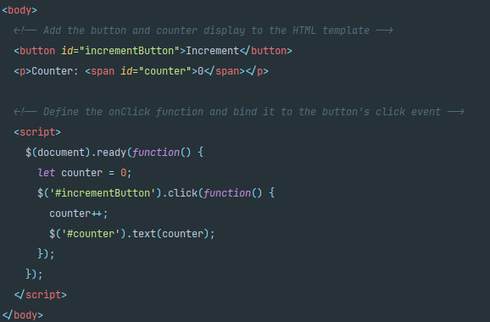
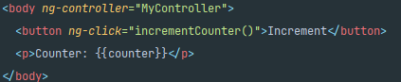
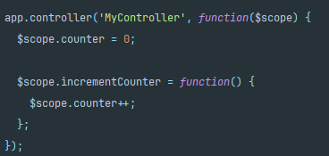
React is Different
JQUERY
Angular1(js)
Notes:
Before react most of the common frameworks would manipulate the DOM by finding elements in already rendered html templates and calling methods or setting properties on them.
Before I worked with React I'd only worked with Angularjs(just Angular at the time) and a little bit of jsquery and they had a wildly different philosophy for adding functionality to the page. They were more html-first where you wrote your html templates and js separate and then bound your js to DOM events somehow

Slide 34
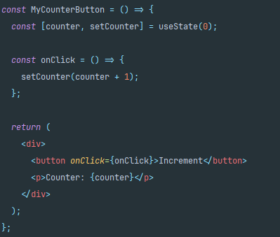
React is Different
HTML* is the product of the js functions.
Breaks the UI into components
Components contain state
Updates to state trigger a render
Builds a "virtual DOM" snapshot on render
Compares new snapshot with previous snapshot
Paints differences into the "real DOM"
Notes:
React takes a Different approach. In React, The DOM is the product of your code. Your components output html-like markup called JSX that makes the "virtual DOM" then that newly generated "virtual DOM" is compared to the previously generated one and paints the differences in the real DOM.
This requires a completely different way of thinking about how you structure your code.
But coming from limited js experience before this with Agular(1) and jquery development I found a much harder way to do things.

Slide 35
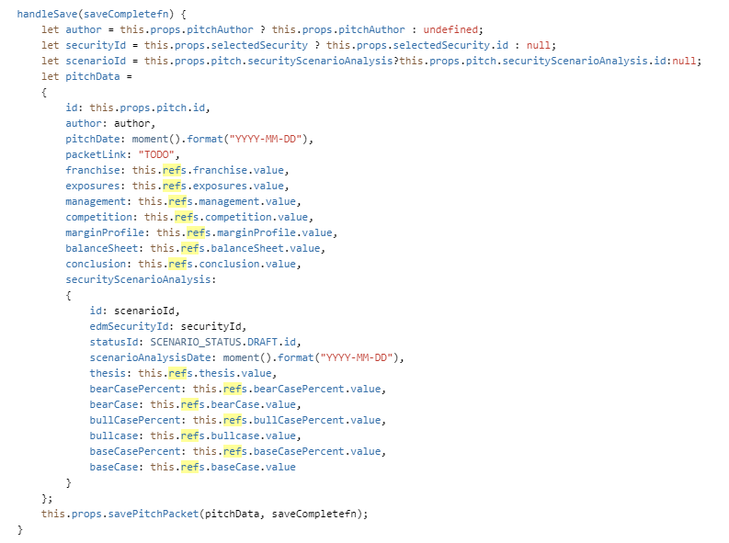
Refs
Reacts built in way to manipulate the DOM
Notes:
The way react manipulates the dom
The first few forms I tried to write in React I thought using Refs were the way to go.
This is probably the worst way to use refs.
This goes against how React works
If anything else needs to update based on the state of those inputs they’d have to continue to interface with the DOM instead of observing that state.
You should use the react’s lifecycle to your advantage when you can
A more common use case would be to control focus on a page and things like that.

Slide 36
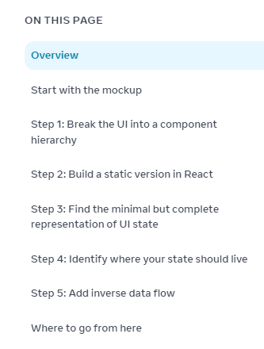
Thinking In React
Notes:
The first resource I send to anyone asking how to get started working with react is a page in react’s own documentation titles “thinking in react” that breaks down how different react is from the popular frameworks that came before it.
It's a framework for helping you identify your different components, your different bits of state, and where it would make the most sense for that state to live.

Slide 37
Understand what you're using
If it feels hard to work with you might be doing it wrong
Notes:
Before working with any technology be sure you understand what exactly it is doing and HOW it’s doing this. Specifically what makes this different from other tech I may have used to accomplish this goal in the past.
If it feels like it's difficult to accomplish simple or common things and you're wondering "how is this thing so popular?" You're probably using it wrong.
These struggles made me a better developer.
Hopefully someone out there can learn from my mistakes.

Slide 38

Summary
Break up your components/ think composability
NEVER define components inside components
Derive. Don’t copy
Flatten your objects
Minimize life-cycle logic
Try to learn one thing at a time
Think in react
Notes:
So that’s my list of lesson I’ve learned in Reactjs. Despite how frustrating it was, I had a lot of fun. Hopefully you enjoyed this talk and got something from it. Even if it was just a few laughs.
These struggles made me a better developer.
Hopefully someone out there can learn from my mistakes.

Slide 39
Thank You!

